Slide 1
Credit Score Prediction app
Amira el-gAREm

Slide 2

Purpose
Predict customer credit scores (Credit_Score).
Support lending decisions, risk stratification, and personalized offers.

Slide 3




Dataset Overview
100,000 rows (8 months per customer) → ~12,500 unique customers.
29 columns including demographic, credit behavior, loan info, monthly balances.
Target: Credit_Score (categorical/multi-class).
Key Columns include Customer_ID, Month, Demographics ( Age, Occupation, Annual_Income, Monthly_Inhand_Salary) , Loans & debt info ( Num_of_Loan, Type_of_Loan, Outstanding_Debt, Total_EMI_per_month, Credit_History_Age, etc.)

Slide 4



DATASET Modeling APPROACHES
Sequence-level
Aggregated (customer-level )
customer-level
8 rows per customer, captures month-to-month variation
~100k rows
more data but noisier
~12.5k rows
Mode (categorical) + Median (numerical) → best performance
~12.5k rows
Only latest month per customer → lower predictive power

Slide 5
PLAN FOR PRODUCT LAUNCH
Exploration
Cleaning
Cleaned numeric, categorical columns (removed underscores/dots, coerced to numeric, absolute values).
Preprocessing
Imputation Strategy:
Models & Tuning
Feature Engineering/ Dropping
Converted Credit_History_Age to months.
Flagged out-of-bound values as NaN.
Flagged sequential inconsistencies (sudden jumps) as NaN.
Stable columns (age, occupation, bank counts) → mode per customer, fallback to global mode.
Sequential columns (balances, delays) → median per customer, fallback to global median.
Credit_History_Age: forward-fill (+1 month) then backward-fill (-1 month) per customer.
EMI_to_Salary_Ratio = Total_EMI_per_month / Monthly_Inhand_Salary
Debt_to_Income_Ratio = Outstanding_Debt / Annual_Income
OrdinalEncoder for ordered categorical fields (e.g., Payment_of_Min_Amount, Credit_Mix).
RobustScaler for numeric columns.
PCA tested (retain 90% variance) to speed up non-aggregated model. Feature selection tested— no features removed.
Columns with low importance (Occupation, Payment/Spending behavior) dropped.
Models: RandomForest, KNN, GaussianNB, XGBoost, CatBoost, LightGBM.
Hyperparameter tuning via RandomizedSearchCV (5-fold CV).
Class imbalance handled with class_weight where supported.
Checked for missing values in all columns.
Verified data types to ensure consistency for numeric and categorical fields.
Reviewed summary statistics ( min, max).
Identified illogical numeric values (negative ages, balances, or debts).
Detected inconsistent categories (e.g., spelling errors or duplicate labels).
Checked for redundant or duplicate columns and removed them if necessary.

Slide 6
Results & Model Selection
Model | Train Accuracy | Test Accuracy | F1 Score
RandomForest | 1.000 | 0.754 | 0.746
KNN | 0.788 | 0.715 | 0.704
GaussianNB | 0.685 | 0.685 | 0.683
XGBoost | 0.969 | 0.744 | 0.733

Slide 7
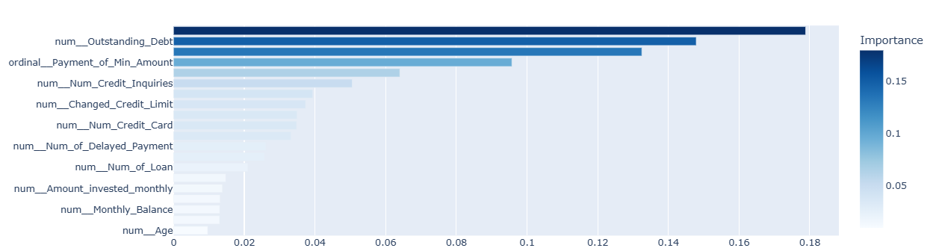
Random Forest Feature Importance

Slide 8
THANK YOU Go to App Here

